Slide 1
Pengantar kuliah Kecerdasan Komputasional
Chastine Fatichah

Slide 2
Deskripsi Matakuliah
  Nama MK : Kecerdasan Komputasional
  Sks : 3
  Semester : 5
  MK Prasyarat : Kecerdasan Buatan
  Kelas : D (IF-101)
  Jadwal : Rabu, 09.30 – 12.00
  Dosen : Nanik Suciati

Slide 3
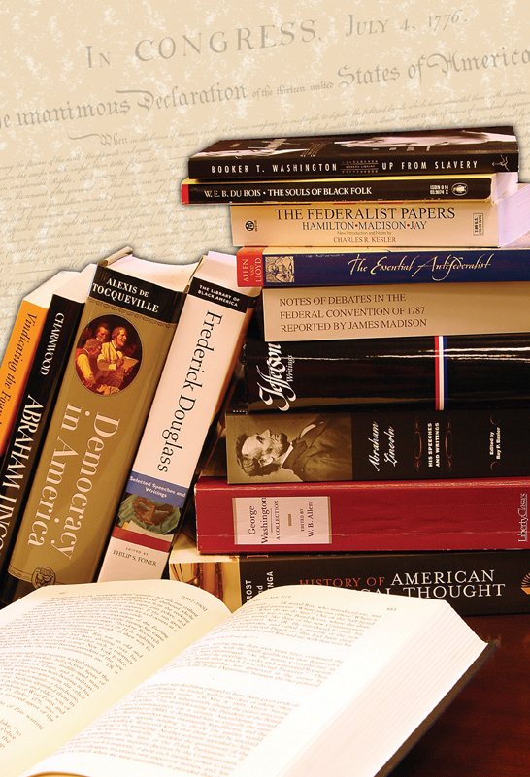
Daftar Pustaka
Utama
  Tom Mitchell, Machine Learning, McGraw-Hill, 1997.
  Christopher Bishop, Pattern Recognition and Machine Learning. Springer, 2006.
  Andries P. Engelbrecht, Computational Intelligence An Introduction, Second Edition, John Wiley & Sons Ltd, 2007
Pendukung
  Michael Negnevitsky, Artificial Intelligence: A Guide to Intelligent Systems, Second Edition, Addison Wesley, 2002
  Amit Konar, Computational Intelligence, Springer, 2005
  Arthur K. Kordon, Applying Computational Intelligence, Springer-Verlag Berlin Heidelberg 2010
  S. Sumathi, Surekha P., Computational Intelligence Paradigms : Theory and Applications using MATLAB, CRC Press, 2010

Slide 4


Computational Intelligence
A set of nature-inspired computational methodologies and approaches to address complex real-world problems to which mathematical or traditional modelling can be useless for a few reasons: the processes might be too complex for mathematical reasoning, it might contain some uncertainties during the process, or the process might simply be stochastic in nature.
  Computational Intelligence provides solutions for complicated problems.
  It primarily includes artificial neural networks, evolutionary computation and fuzzy logic.
  Also embraces biologically inspired algorithms such as swarm intelligence and artificial immune systems.
The theory, design, application, and development of biologically and linguistically motivated computational paradigms
  neural networks,
  genetic algorithms,
  evolutionary programming,
  fuzzy system,
  hybrid intelligent systems

Slide 5
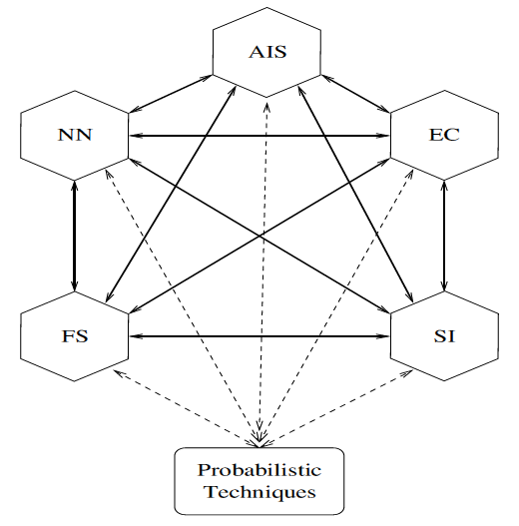
Computational Intelligence Paradigms
Andries P. Engelbrecht, Computational Intelligence, 2007
AIS : Artificial Immune Systems
NN : Neural Network
EC : Evolutionary Computation
FS : Fuzzy System
SI : Swarm Intelligence

Slide 6

Focused on the design-analysis of intelligent/ autonomous agents
An intelligent system has ability …
  to observe its environment,
  to act rationally on its assigned tasks,
  to interact with other agents or human beings.
  AI provides a set of tools for solving problems …
  search algorithms
  knowledge representations and reasoning
  machine learning
  methods for sensing and action problems: speech and language understanding, computer vision, robotics, etc
agent disebut autonomous jika perilaku ditentukan oleh pengalaman sendiri (kemampuan untuk belajar dan beradaptasi)
KI141315 Kecerdasan Buatan (sem 4)
KI141322 Kecerdasan Komputasional (sem 5)
Kurikulum 2014
Mata kuliah pilihan (sem 6-8)

Slide 7
Materi
Introduction to computational intelligence
Nearest Neighbor Classifiers (k-NN)
Decision Tree
Fuzzy Inference System
Support Vector Machine
Artificial neural networks : single & multi layer perceptron, back propagation algorithm
Clustering : K-Means & Hierarchical Clustering, SOM
Evolutionary algorithm : Genetic Algorithm (GA)
Swarm Intelligence : Particle Swarm Optimization (PSO)

Slide 8
Penilaian
Tugas ➔ 30%
  Tugas 1 : KNN → 10%
  Tugas 2 : Decision Tree → 10%
  Tugas 3 : ANN →10%
ETS ➔ 30%
Final Project : gabungan lebih dari 1 metode klasifikasi ➔ 40%

Slide 9

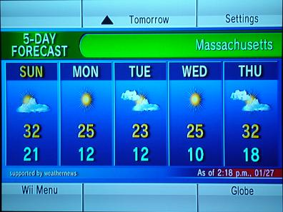
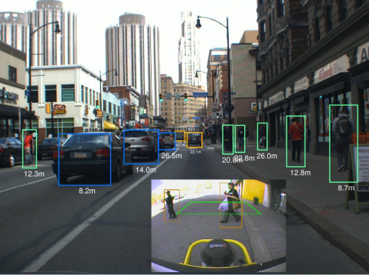
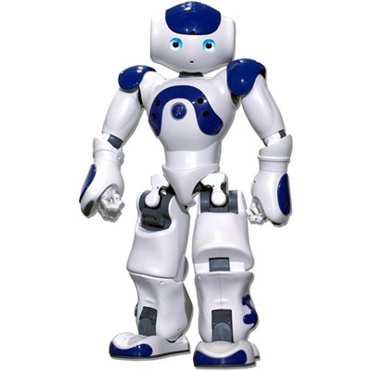
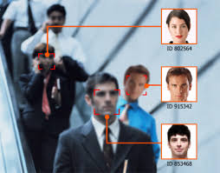
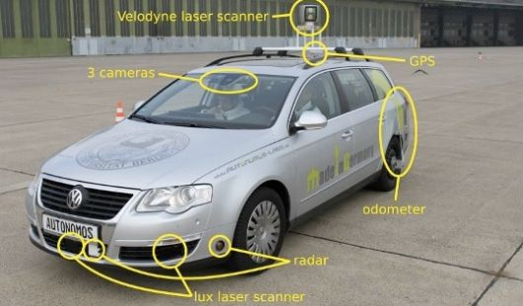
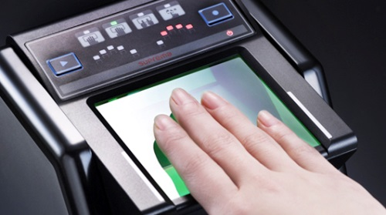
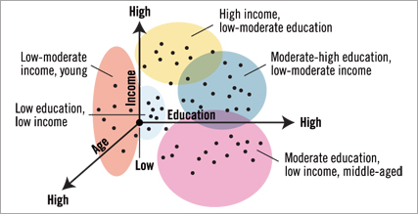
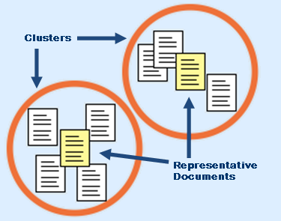

Slide 10

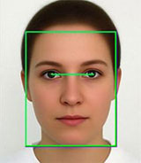
Application Types
Prediction (Regression)
  Stock index, weather, selling,…
Classification (Recognition)
  Voice, character, face, disease,…
Clustering
  Document, data social media, image segmentation, …

Slide 11
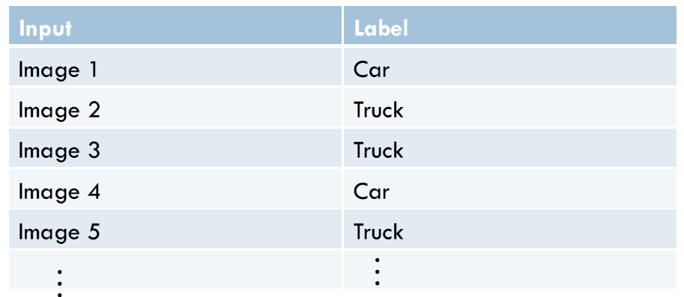
Learning Algorithm TYPES
To be used when, "I know how to classify this data, I just need you(the classifier) to sort it."
Supervised
  If labelled training data that associates input observations with class labels are available

Slide 12
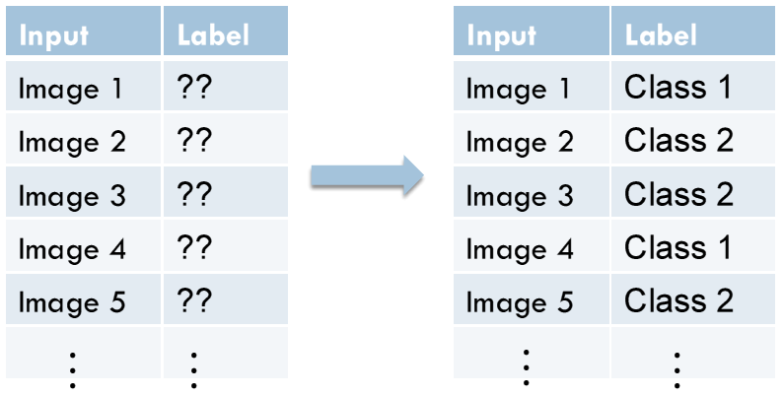
Learning Algorithm TYPES
To be used when, "I have no idea how to classify this data, can you(the algorithm) create a classifier for me?"
Unsupervised
  If the training data consist of input observations of unknown class
  This is called clustering

Slide 13
Learning Algorithm TYPES
To be used when, "I have no idea how to classify this data, can you classify this data and I'll give you a reward if it's correct or I'll punish you if it's not."
3. Reinforcement
  A computer program interacts with a dynamic environment in which it must perform a certain goal, without a teacher explicitly telling it whether it has come close to its goal or not
Supervised Learning:
Example Class
Reinforcement Learning:
…
Situation Reward
Situation Reward

Slide 14
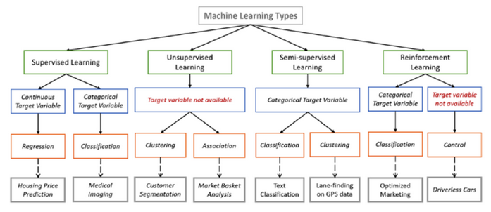
Some references in machine learning types:
https://medium.com/towards-data-science/types-of-machine-learning-algorithms-you-should-know-953a08248861
https://machinelearningmastery.com/a-tour-of-machine-learning-algorithms/

Slide 15
KLASIFIKASI JENIS IKAN
Sekumpulan ikan diletakkan pada ban berjalan
Berdasarkan sensor kamera, mesin dapat mengklasifikasikan ikan-ikan tersebut sebagai SeaBass dan Salmon
Analisa problem
  Set posisi kamera untuk mengambil gambar ikan-ikan
  Dari gambar akan di ekstrak informasi fitur:
    Panjang ikan
    Tingkat kecerahan warna sisik ikan
    Lebar badan ikan
    Jumlah dan bentuk sirip ikan, dll.
PENGENALAN POLA@DP 2006

Slide 16
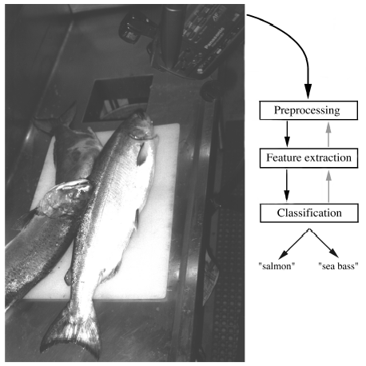

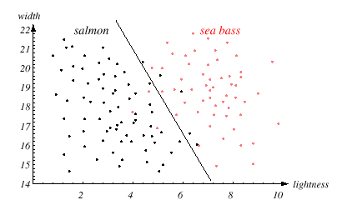
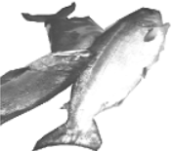
Example application : FISH CLASSIFICATION
kumpulan ikan pada ban berjalan
hasil klasifikasi ikan
Sensor
Pemrosesan citra
ekstraksi fitur
peng-klasifikasi
segmentasi gambar untuk mendapatkan obyek ikan
salmon
gambar ikan-ikan
lebar badan ikan
tingkat kecerahan warna sisik ikan
seabass

Slide 17
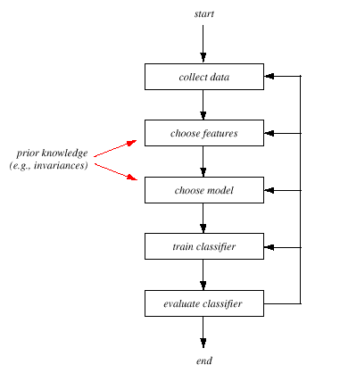
TAHAPAN KLASIFIKASI
Collect data: mengumpulkan data untuk pelatihan dan uji coba
Feature choice: memilih fitur yang akan digunakan sebagai dasar klasifikasi
Model choice: memilih model klasifikasi (metode klasifikasi)
Train classifier: klasifikasi data pelatihan untuk mendapatkan model klasifikasi yg optimal
Evaluate classifier: melakukan evaluasi tingkat kesalahan kemudian mempertimbangkan untuk mengganti fitur

Slide 18

Pilihan Fitur : Lebar + Tingkat Kecerahan Sisik
Digunakan fitur lebar ikan dan tingkat kecerahan sisik ikan
x^{T} = [x₁, x₂]
LIGHTNESS
WIDTH

Slide 19
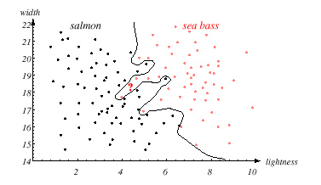
Batas Pemisah (Decision Boundary)Terbaik
Batas pemisah (decision boundary) terbaik memberikan hasil klasifikasi yang optimal

Slide 20
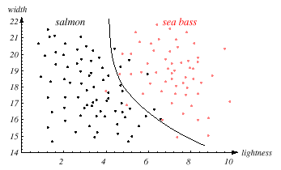
Issue Generalisasi
GENERALISASI
Sistem pengenalan tidak memiliki sifat generalisasi jika
  Sistem hanya dapat mengklasifikasi data pelatihan
  Sistem tidak dapa mengklasifikasi dengan baik data baru

Slide 21
Teori Keputusan (Decision Boundary)
1. Probabilistic Approaches
  Bayesian decision
2. Discriminating Approaches
  Neural Network, SVM,…
3. Rule based Approaches
  Fuzzy Inference System, Decision Tree
4. Distance Approaches
  Nearest Neighbor (k-NN)

